Slide 1
Summary of SmartD project
Xiaotao Shen
October 27th, 2019

Slide 2
Introduction of SmartD project
Questions we want to know form this project:
Invasive diagnosis method for due date.
Urine sample may be a good method.
Notes:
Birth GA – sample GA
Birth GA < 39
Birth GA > 39

Slide 3
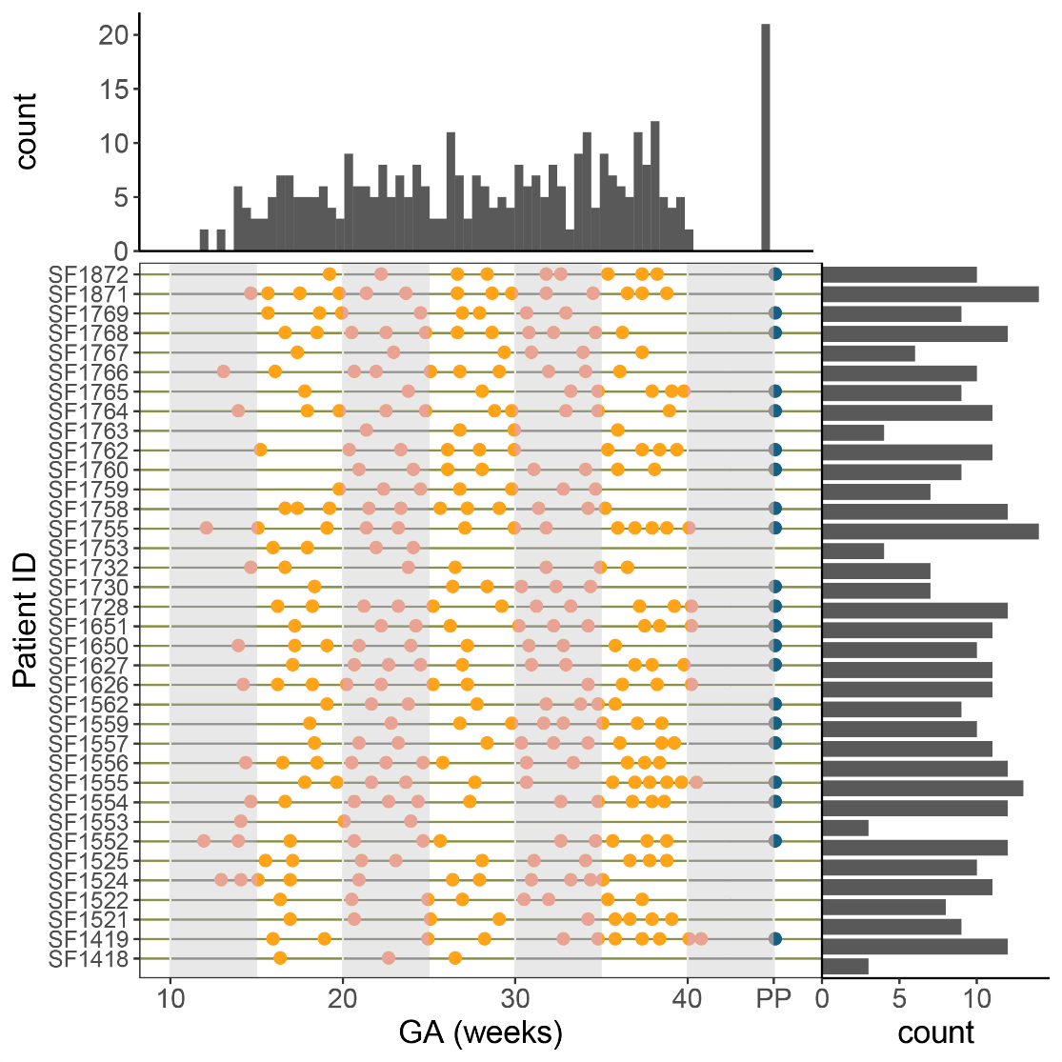
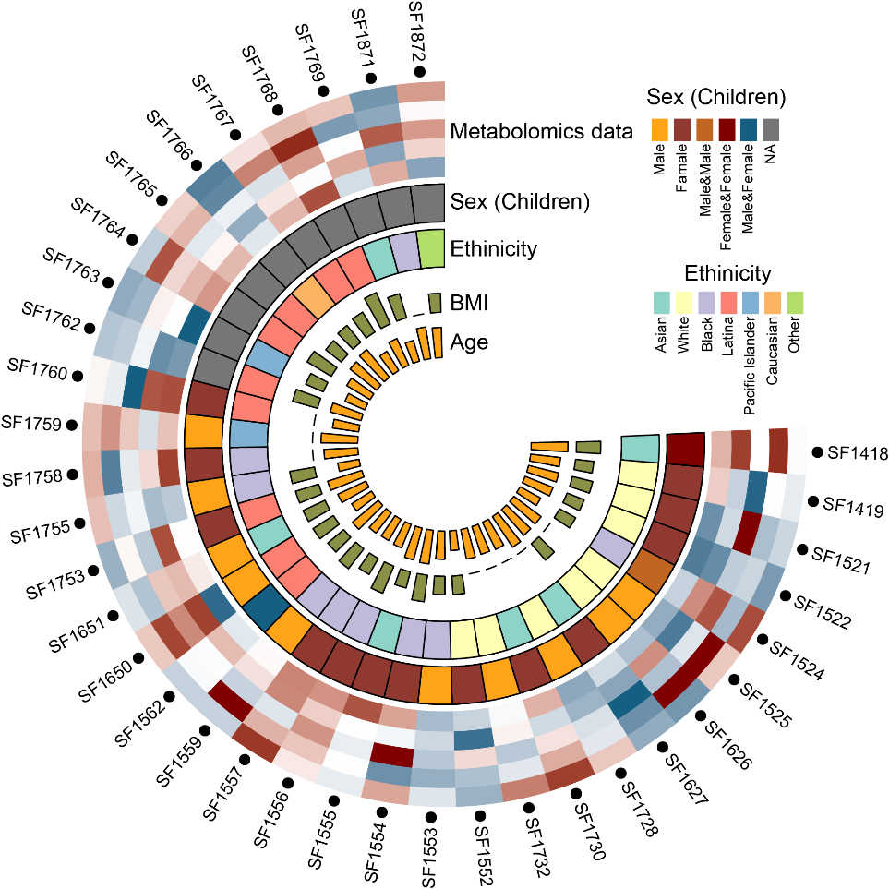
Patient information (sample collection)
36 patients 346 urine samples.
Notes:
Birth GA – sample GA
Birth GA < 39
Birth GA > 39

Slide 4

Data sets and processing
RPLC
Raw data
Peak detection
Batch 1
Positive mode: 145 samples × 5,242 peaks
Negative mode: 145 samples × 4,261 peaks
Batch 2
Positive mode: 185 samples x 4,074 peaks
Negative mode: 185 samples x 4,183 peaks
RT correction
Noisy peak removal
Outlier sample removal
MV imputation
Data normalization
Peak table

Slide 5
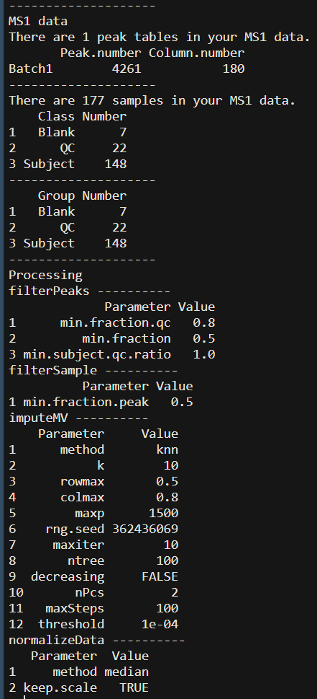
metflow2: A integrated metabolomics data analysis pipeline
RPLC
Raw data
Peak detection
RT correction
Noisy peak removal
Outlier sample removal
MV imputation
Data normalization
Peak table

Slide 6
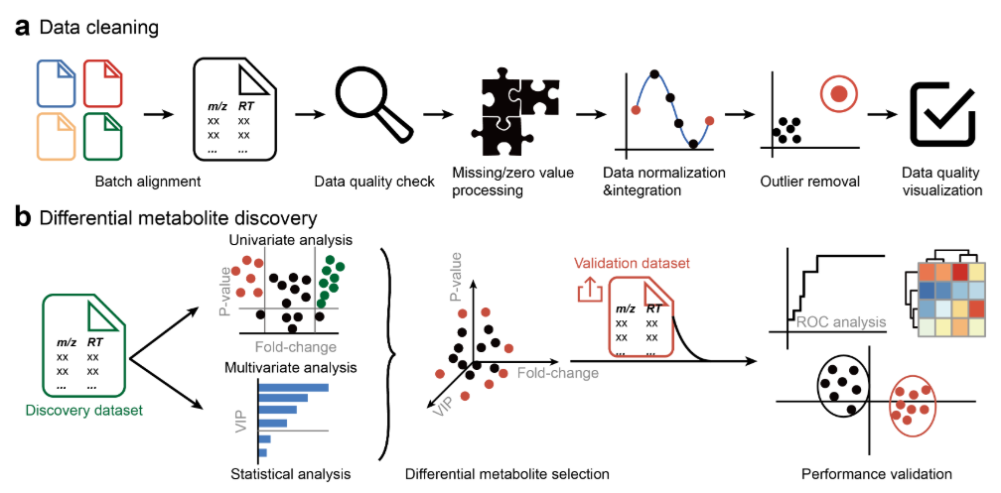
metflow2: A integrated metabolomics data analysis pipeline
Github address:
https://github.com/jaspershen/metflow2

Slide 7

Data sets and processing
Peak table
In-house library match (Level 1)
Public library match (Level 2)
520 metabolites
HMDB accurate mass library match (Level 3)
Annotation redundancy removal
Metabolite table (matrix)

Slide 8
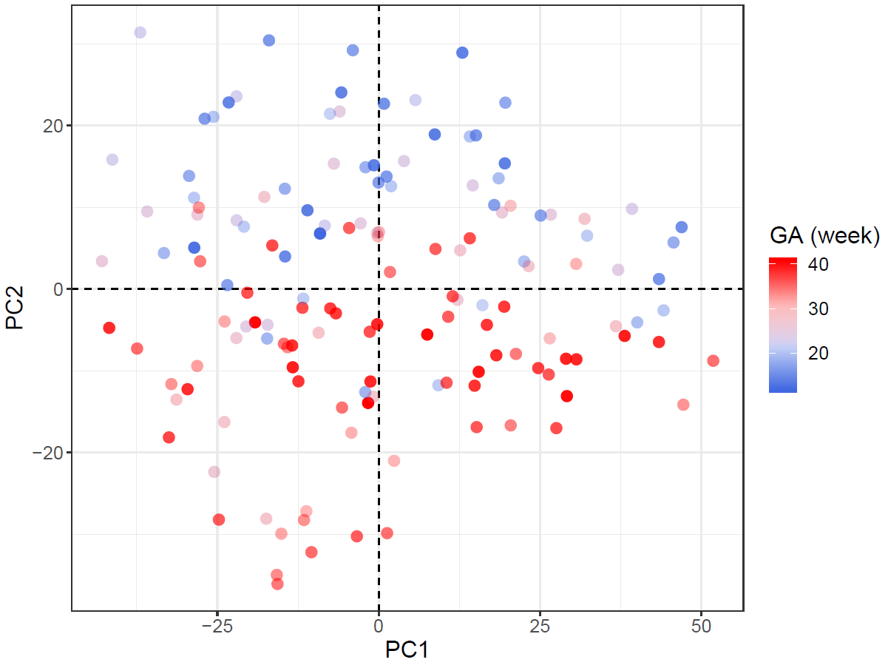
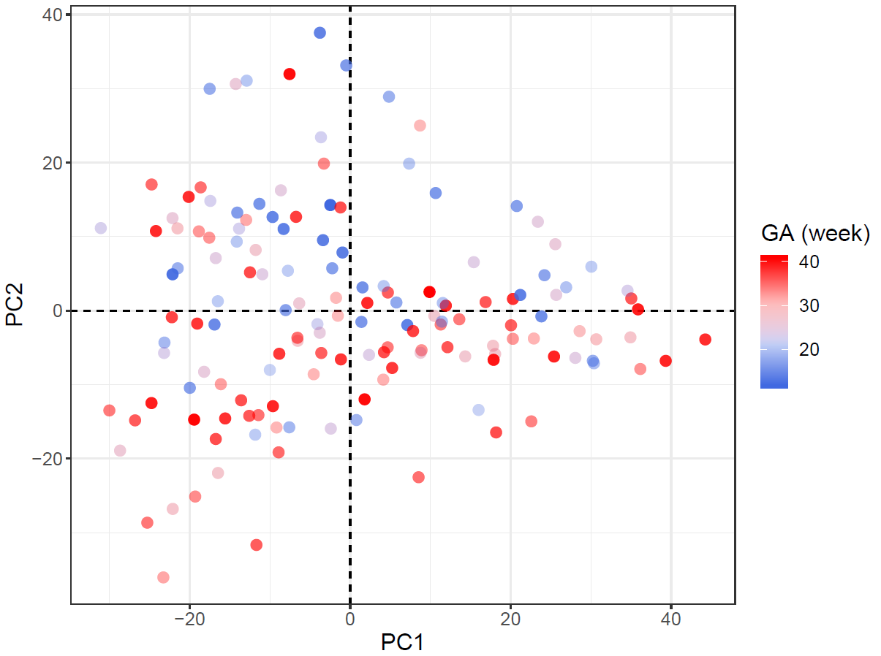
Overall metabolic profile
Unsupervised method (PCA) Batch 1 samples
Positive mode
Negative mode

Slide 9
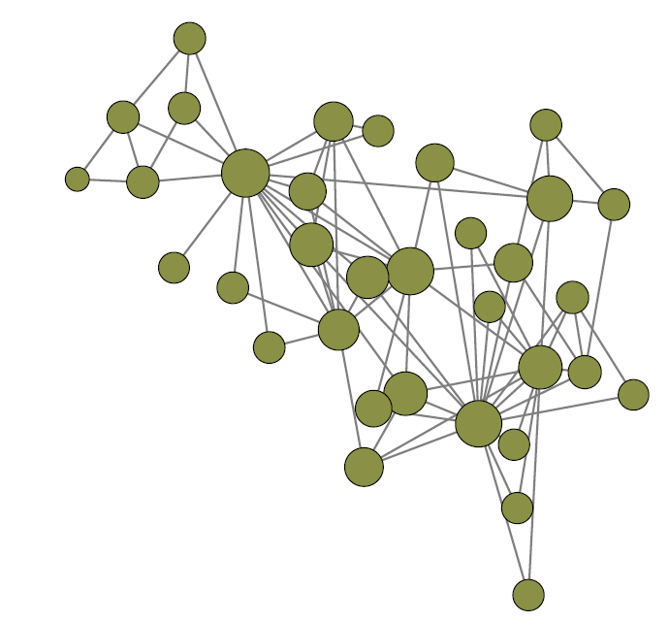
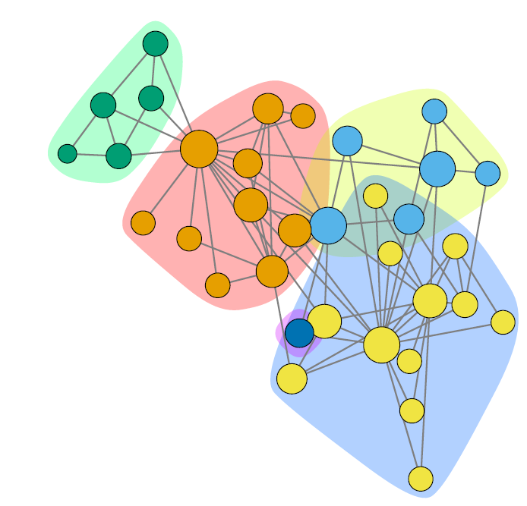
Community analysis for metabolic network
0.4
0.3
Modularity
0.2
0.1
0.0
0
10
20
30
Community analysis iteration
Q: Modularity
m: Total number of edges
A_{ij}: i and j are two nodes in the graph. If i and j are directly connected, A_{ij} = 1, or A_{ij} = 0.
k_{i}/k_{j}: The degree of node i/j.
δ(c_{i},c_{j}): If node i and j are in one subgraph, it equals to 1, or 0.

Slide 10
Two kind of correlation networks
Cross-sectional correlation network
Cross-sectional correlations were calculated from mean measurements of metabolites calculated using all time points (mean A is correlated with mean B across all individuals).
Delta correlation network
Delta correlations were calculated on the change in analytes between time points (the change in A between time points is correlated with the change in B across all individuals).
The communities often represented a cluster of physiologically related metabolites.

Slide 11
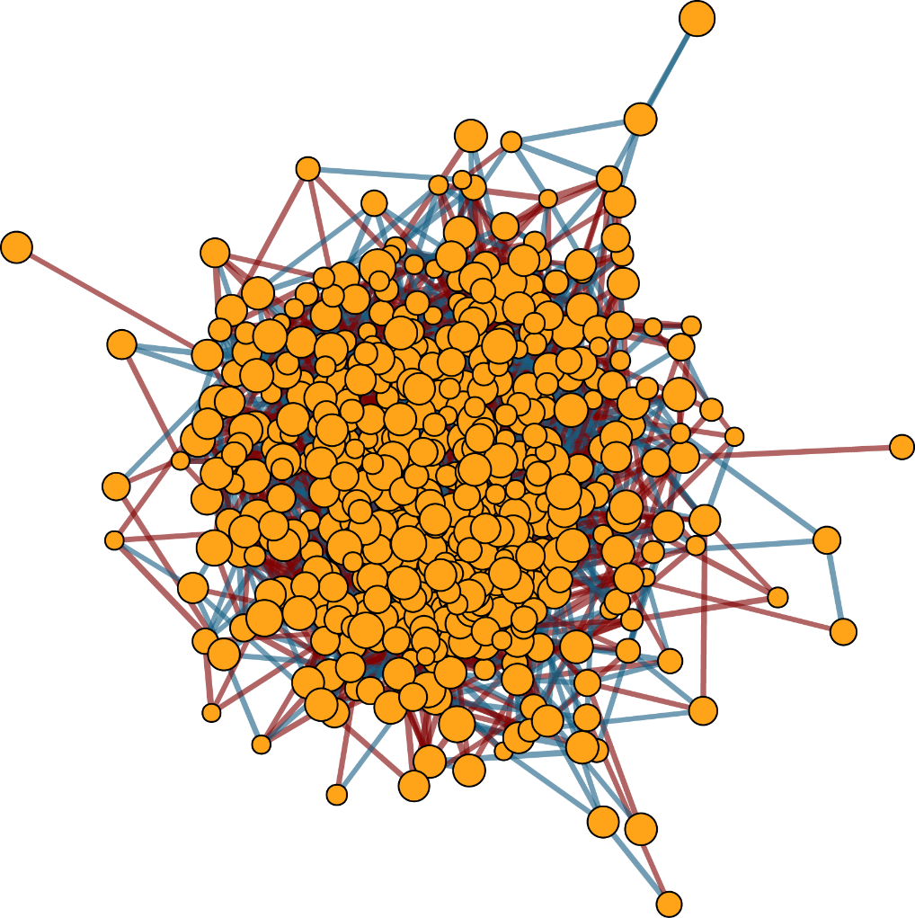
Whole cross-sectional correction network
520 vertexes (metabolites)
4,532 edges
Spearman correlation:
Correlation > 0.5 or Correlation < -0.5
P_{adjust} < 0.05

Slide 12
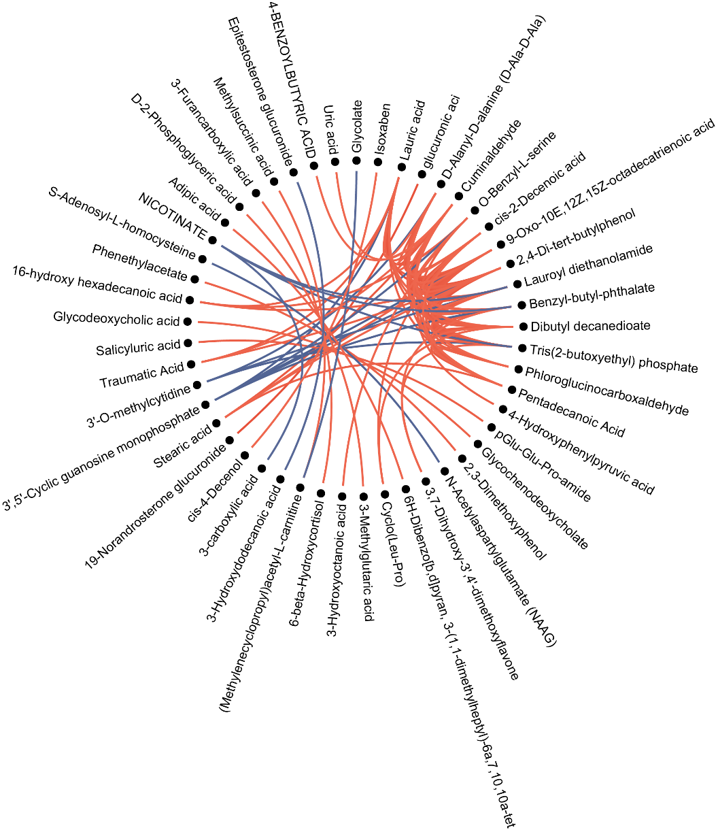
Top 100 correlations of cross-sectional correction network
Subset of top statistically significant Spearman cross-sectional correlations between all data sets collected in our cohort. Each line represents one correlation that was significant after adjustment for multiple hypothesis testing using the method of Benjamini and Hochberg10 at P_{adj} < 0.05.

Slide 13
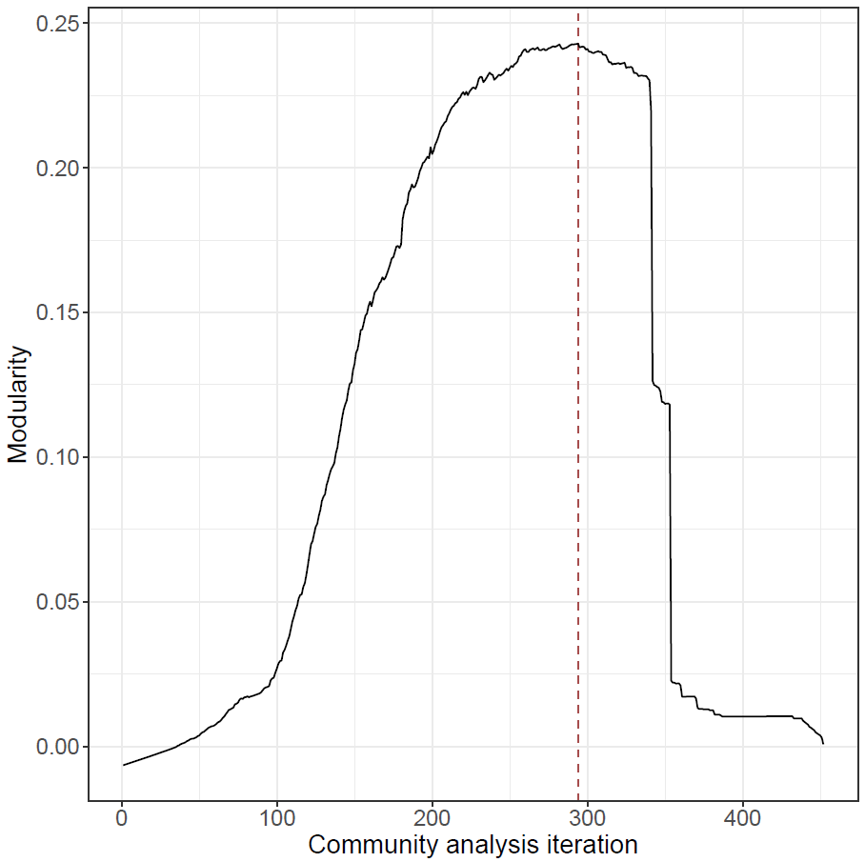
Subnetwork detection using community analysis
Modularity is 0.25 at 365 iteration
50 subnetworks with at least two vertexes (mean of 7.52 V and 48.6 E).
376 out of 520 vertexes (72.3%) are remained after community edge punching.
2430 out of 4532 edges (53.6%) are remained after community edge punching.

Slide 14
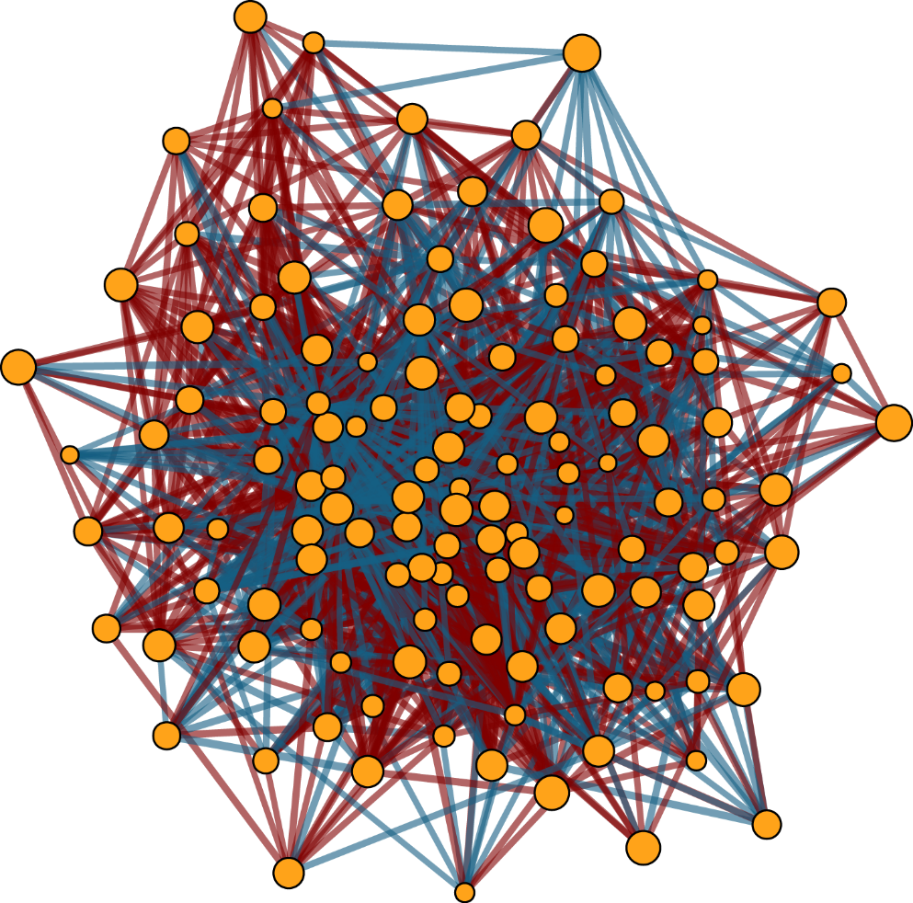
Cross-sectional subnetwork 5
125 vertexes (metabolites)
2,022 edges

Slide 15
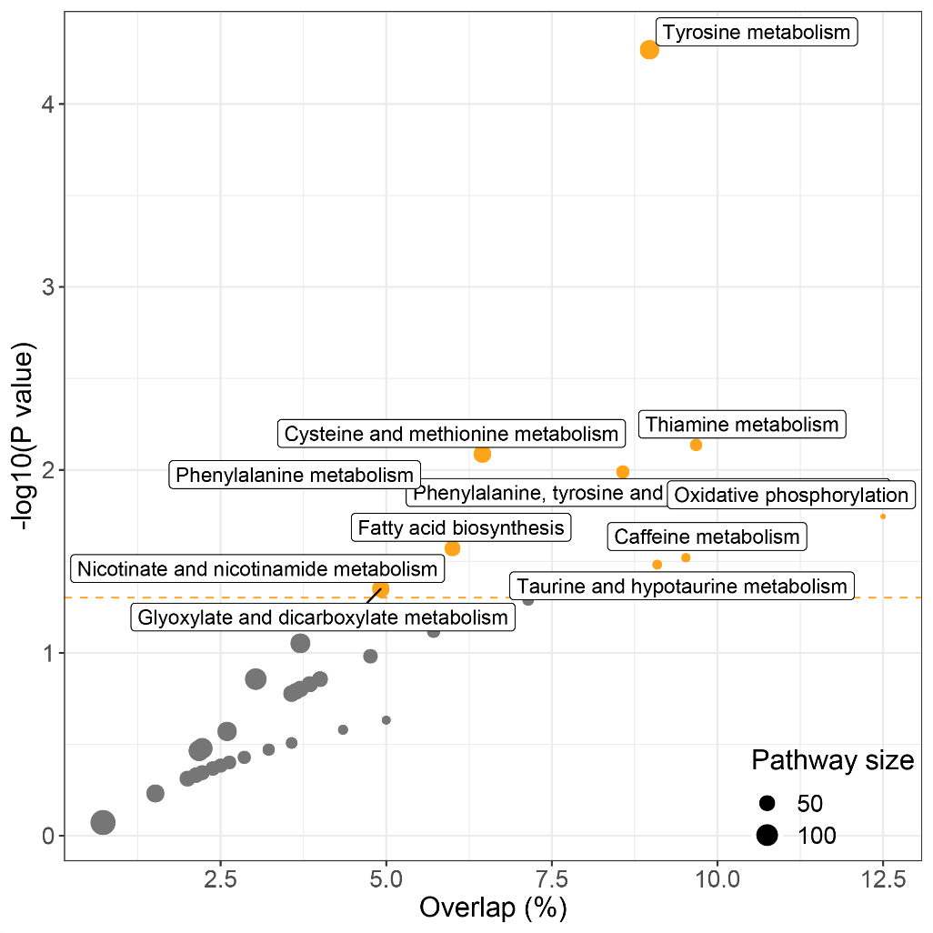
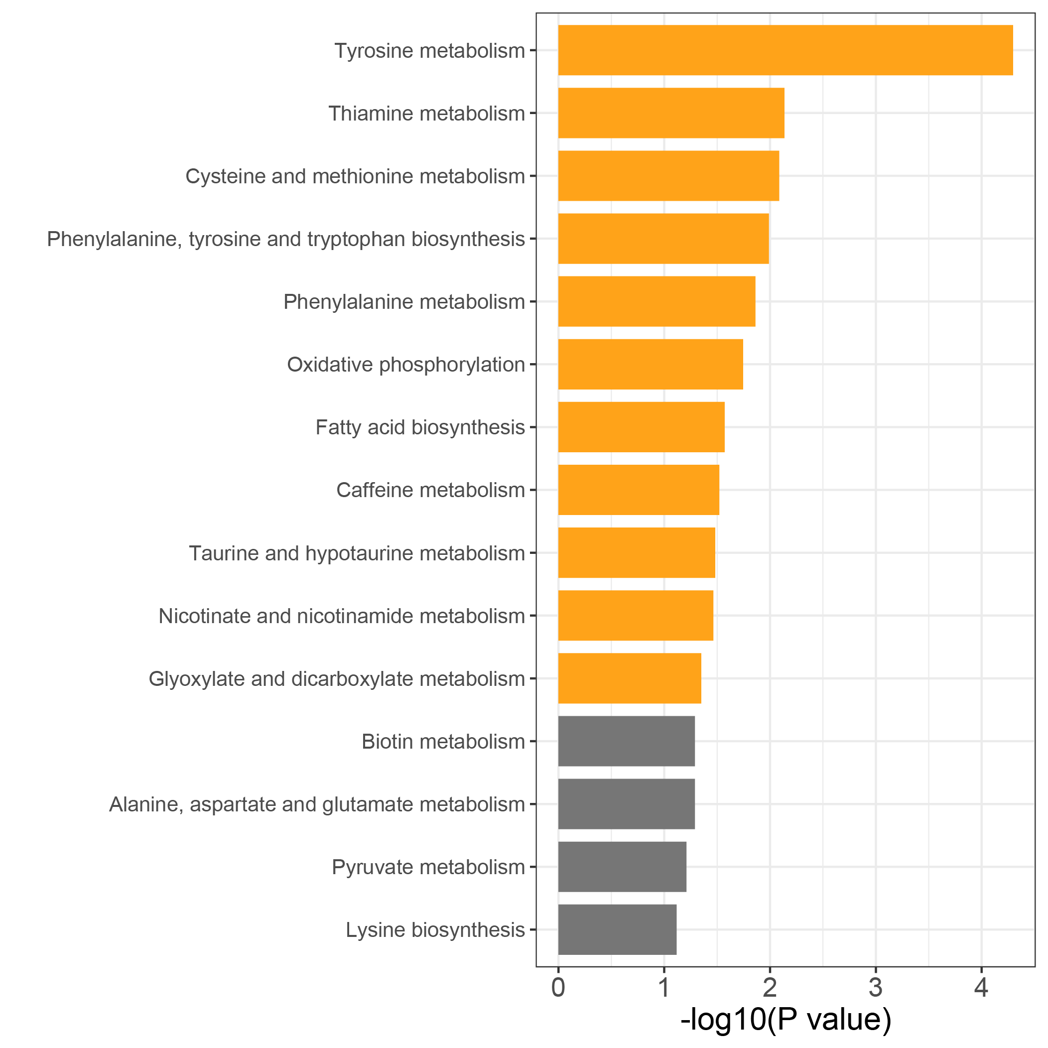
Functional analysis for cross-sectional subnetwork 5
57 our of 125 metabolites have KEGG ID.
Most of them are amino acid metabolism and lipid metabolism.

Slide 16
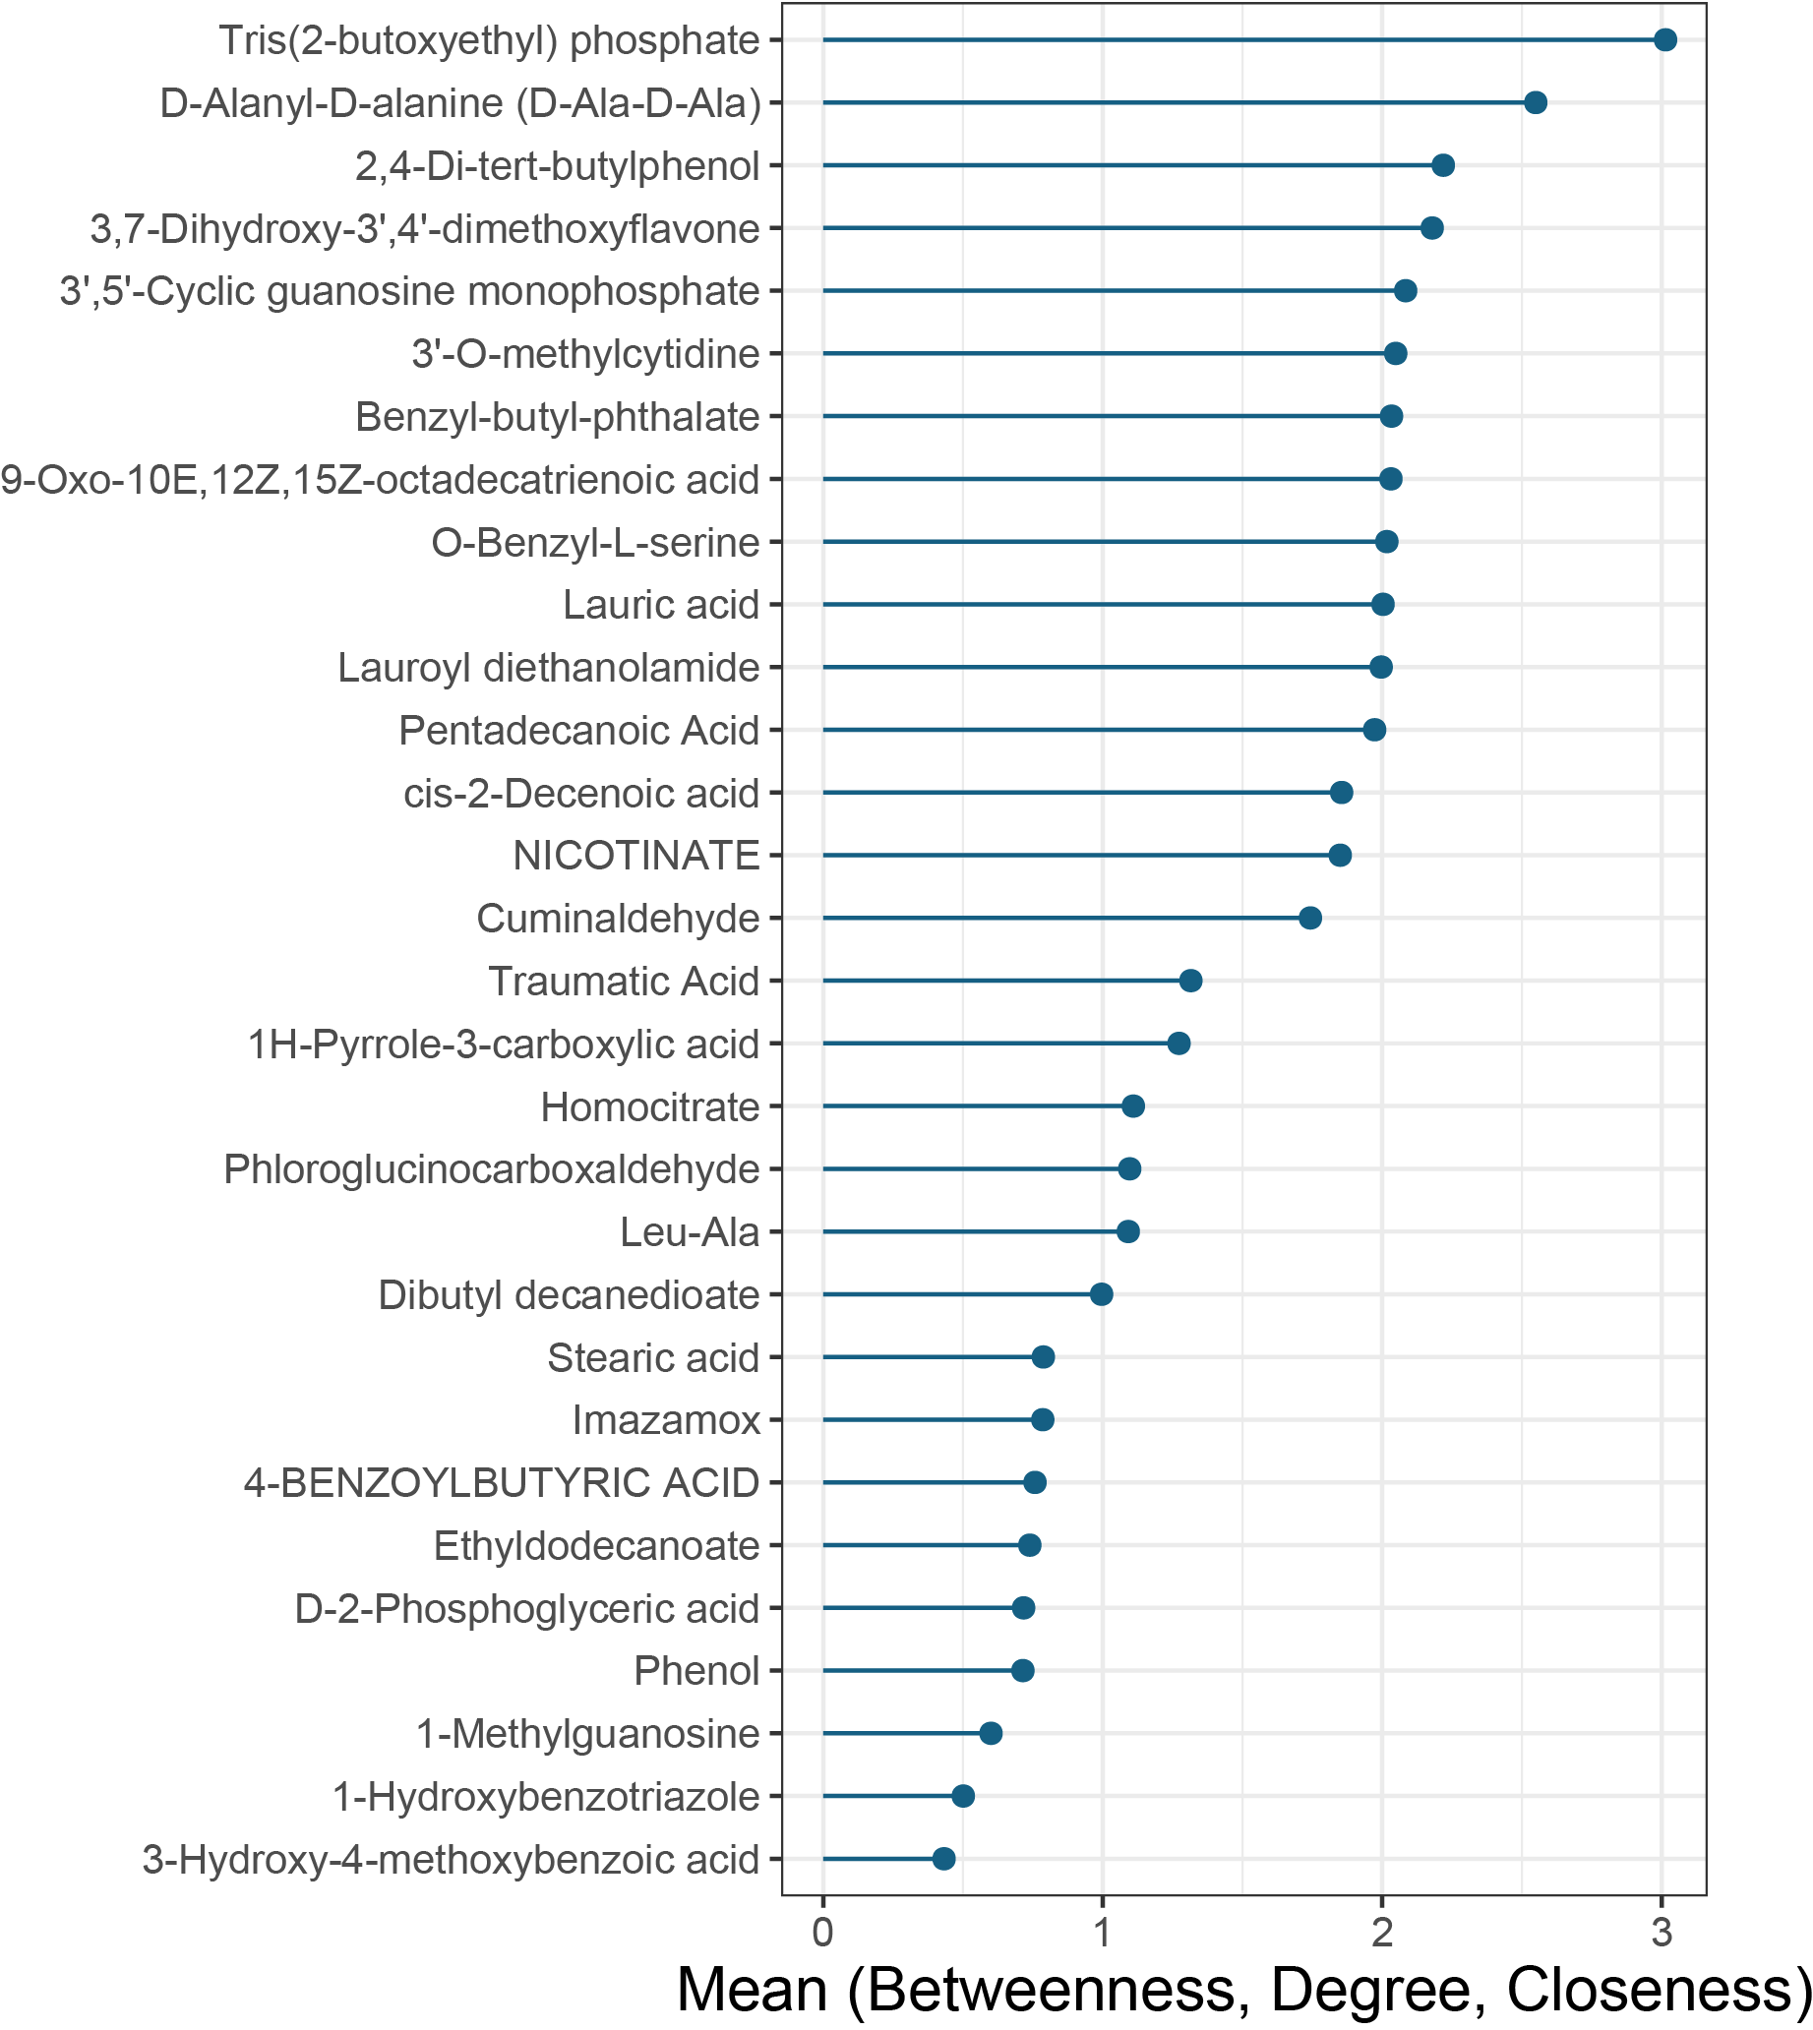
Functional analysis for cross-sectional subnetwork 5
Vertex Importance = mean(scaled betweenness, scaled closeness, scaled degree)
Importance

Slide 17
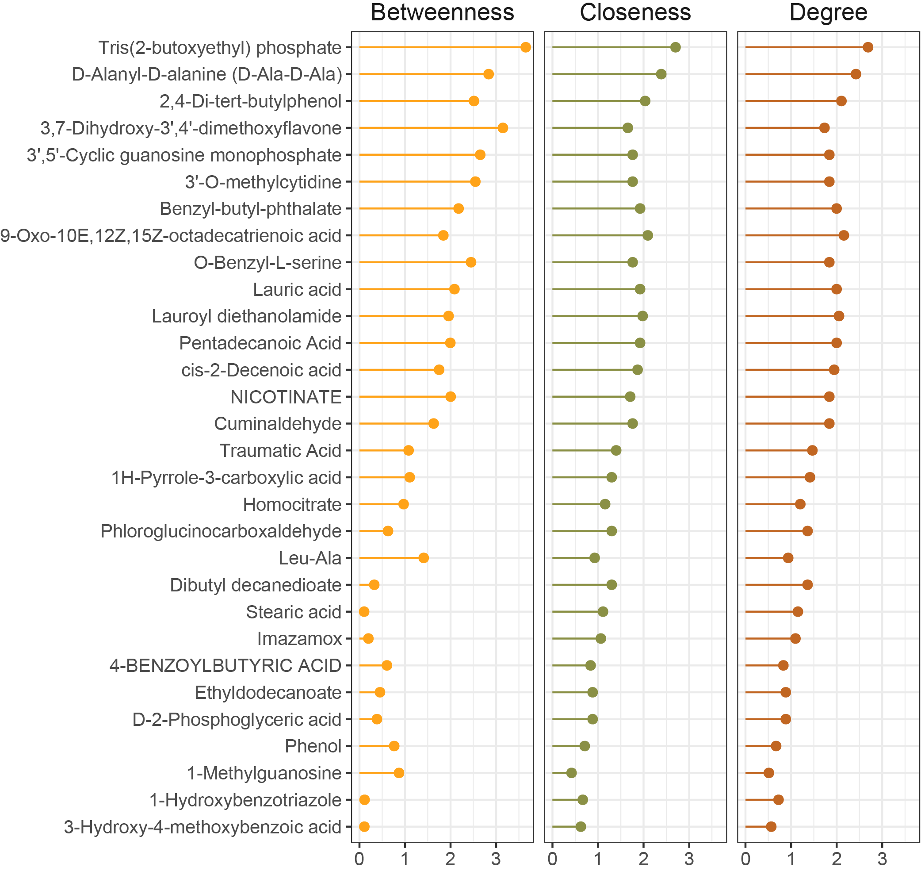
Functional analysis for cross-sectional subnetwork 5

Slide 18
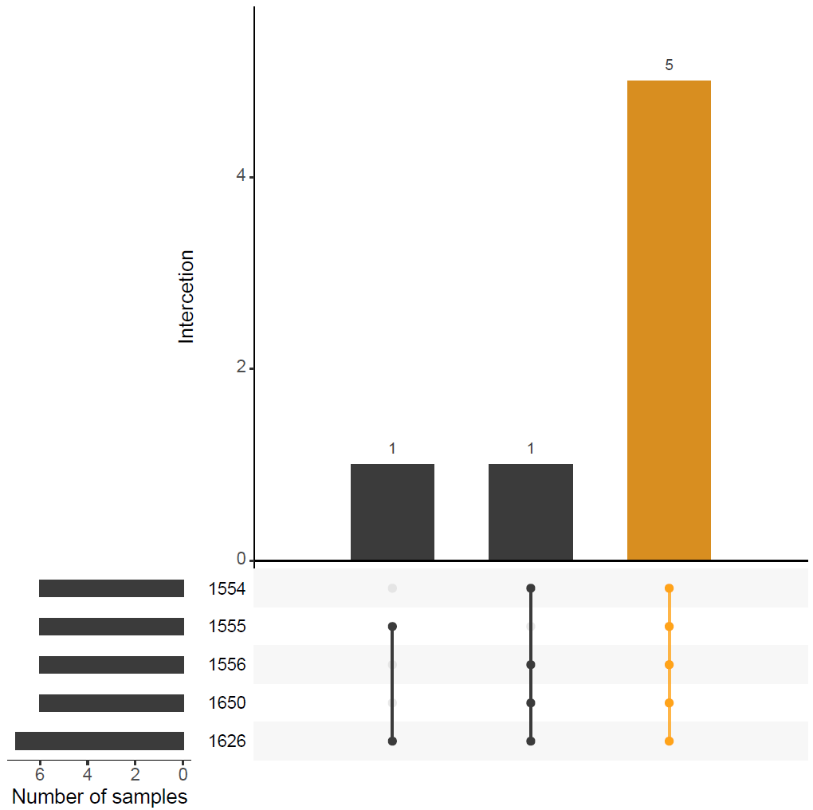
Delta correlation network
15-20, 20-25, 25-30, 30-35, 35-40

Slide 19
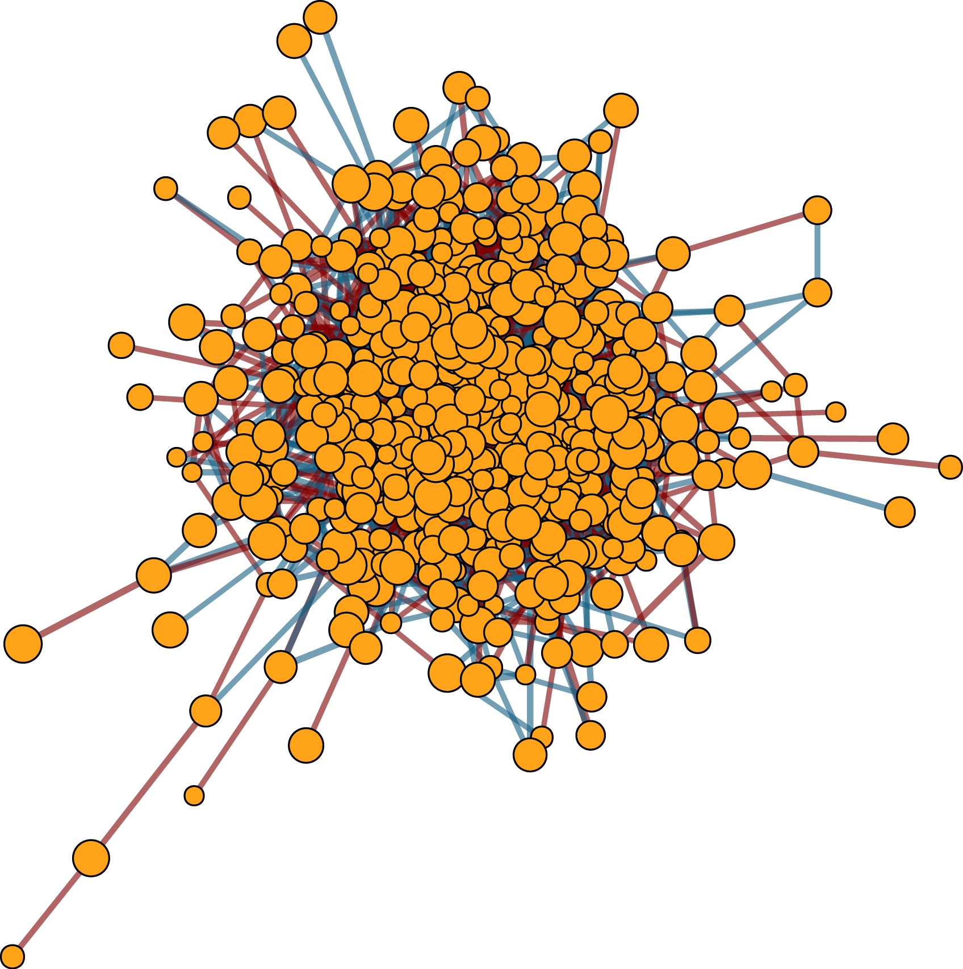
Whole delta correction network
515 vertexes (metabolites)
2,238 edges
Spearman correlation:
Correlation > 0.5 or Correlation < -0.5
P_{adjust} < 0.05

Slide 20
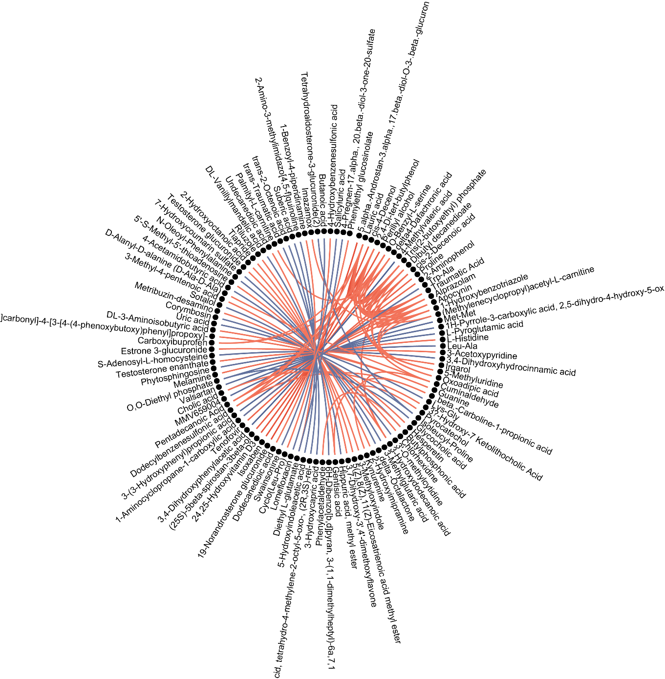
Top 100 correlations of delta correction network

Slide 21
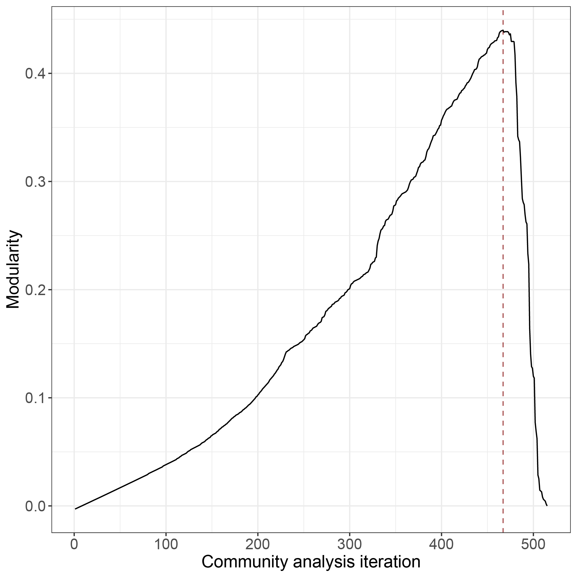
Subnetwork detection using community analysis
Modularity is 0.44 at 467 iteration
43 subnetworks with at least two vertexes (mean of 11.70 V and 27.42 E).
503 out of 515 vertexes (97.7%) are remained after community edge punching.
1,179 out of 2,238 edges (52.7%) are remained after community edge punching.

Slide 22
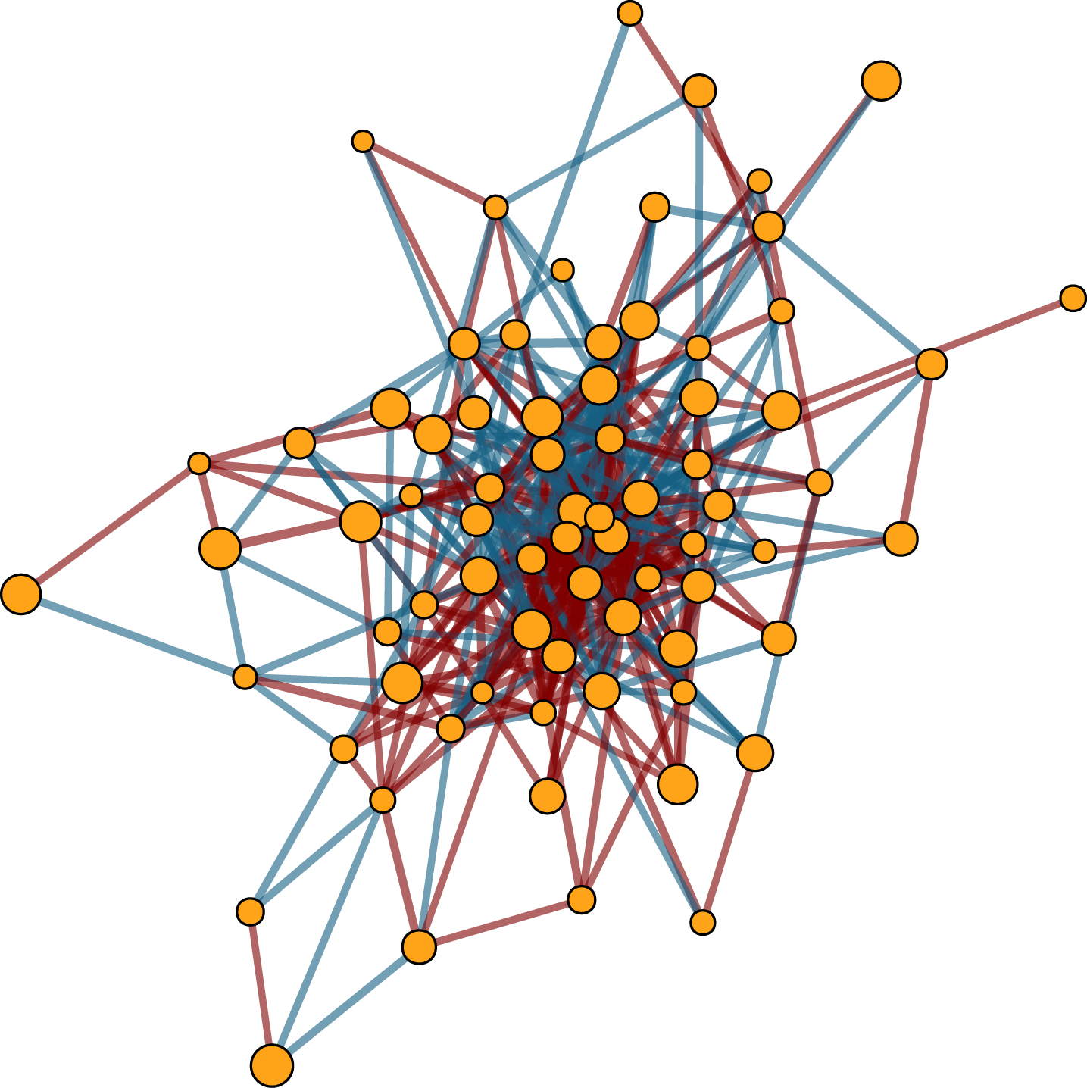
Delta subnetwork 3
74 vertexes (metabolites)
426 edges

Slide 23
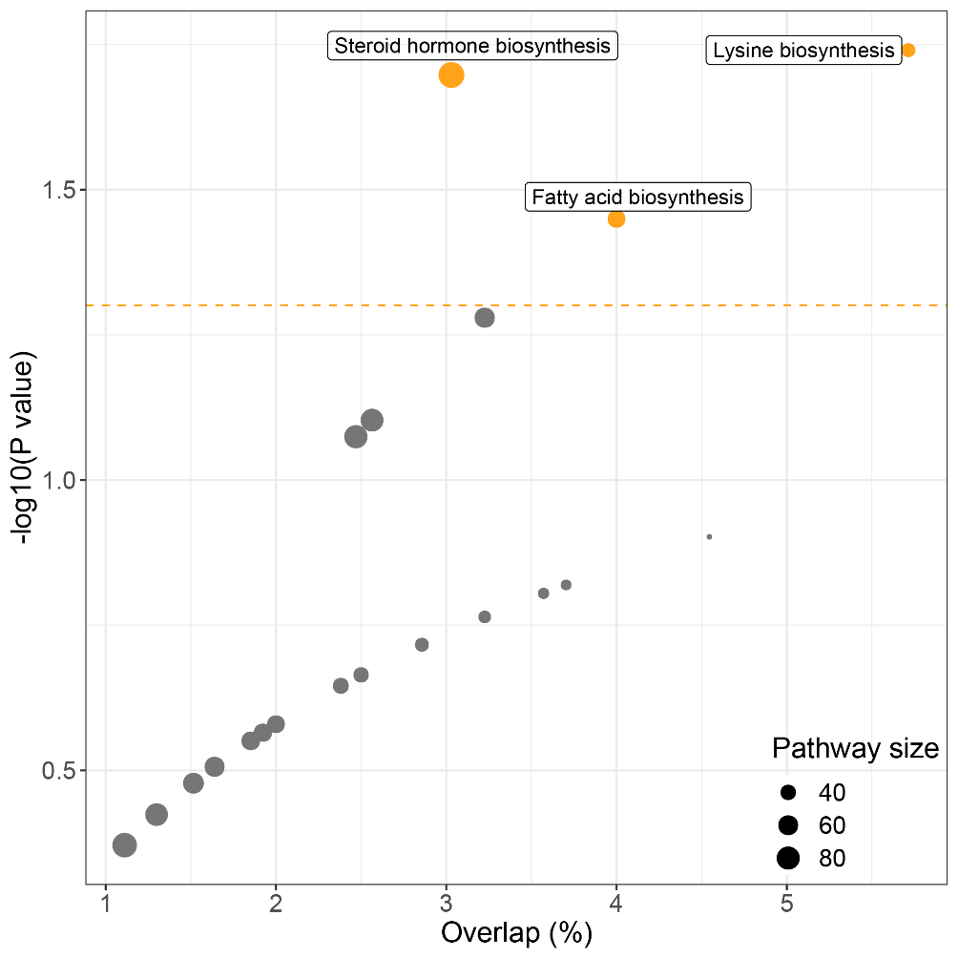
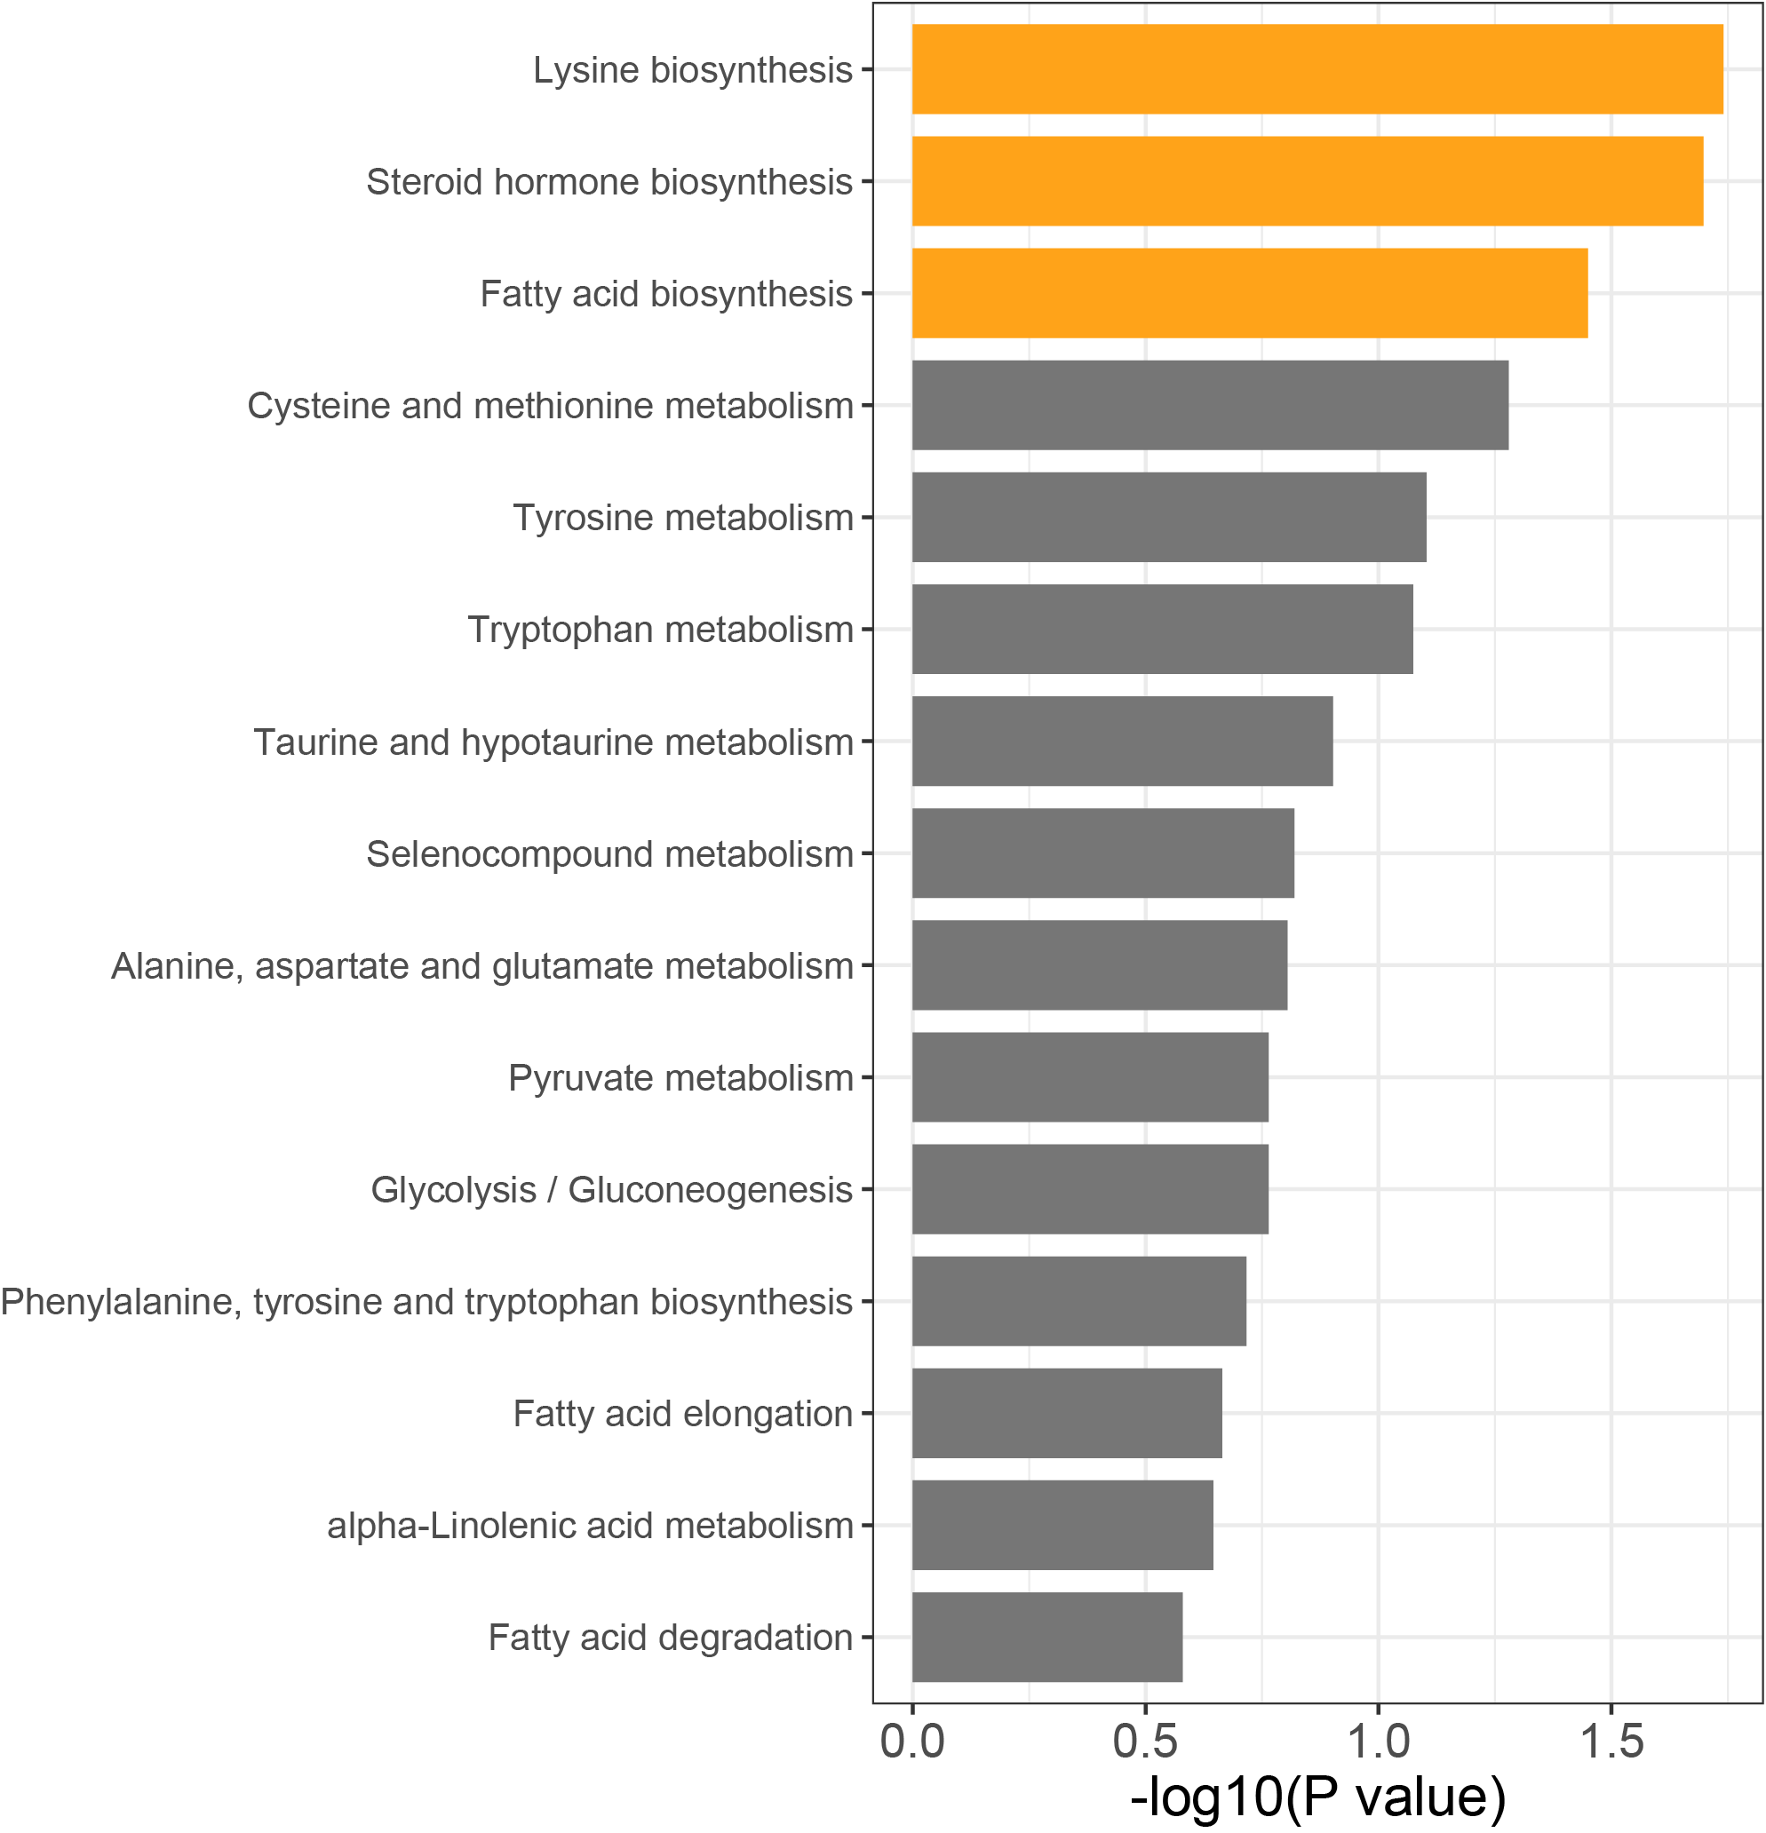
Functional analysis for delta subnetwork 3
33 our of 74 metabolites have KEGG ID.
All of them are amino acid metabolism and lipid metabolism.

Slide 24
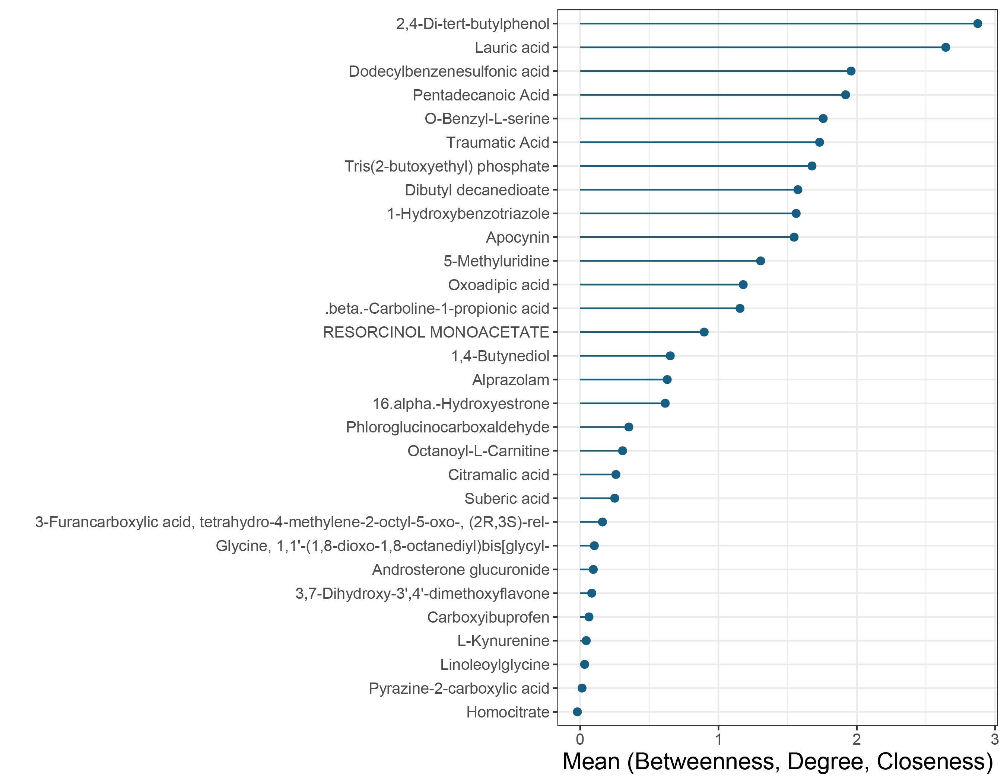
Functional analysis for delta subnetwork 3
Importance

Slide 25
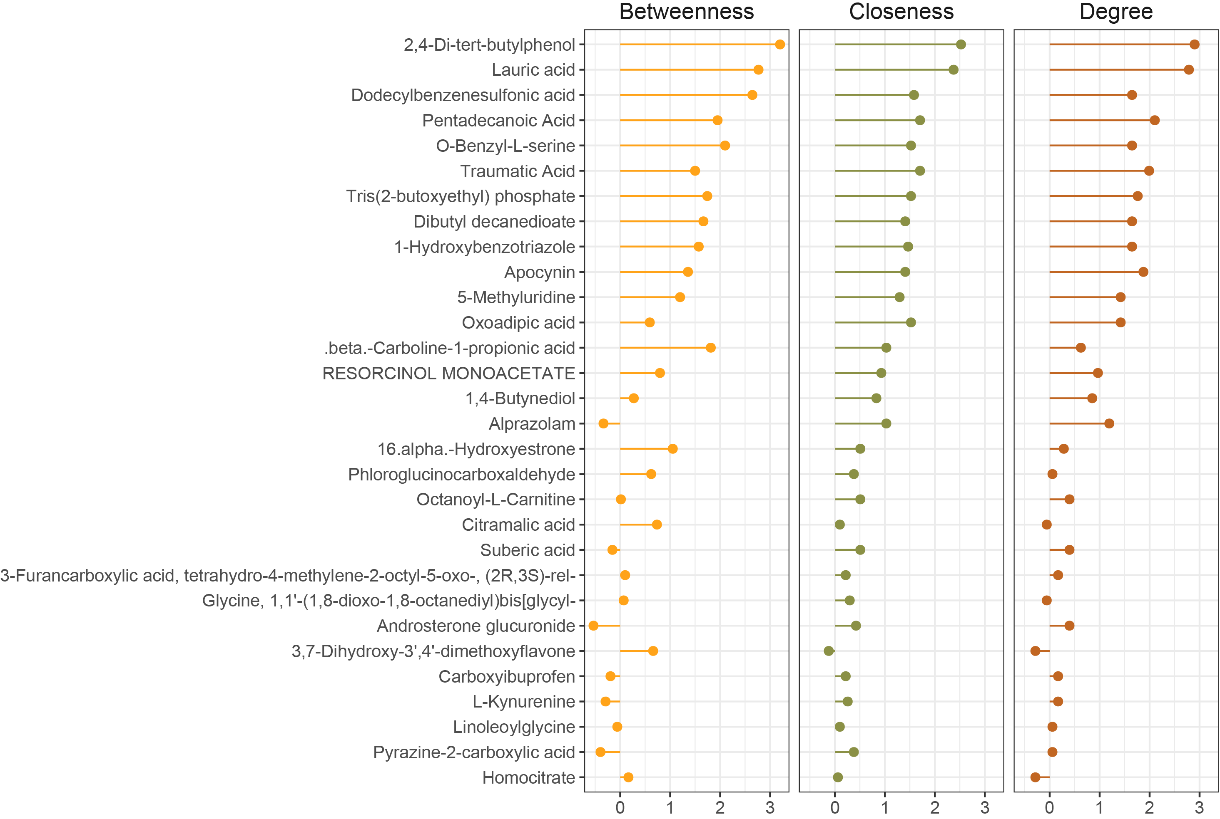
Functional analysis for delta subnetwork 3

Slide 26
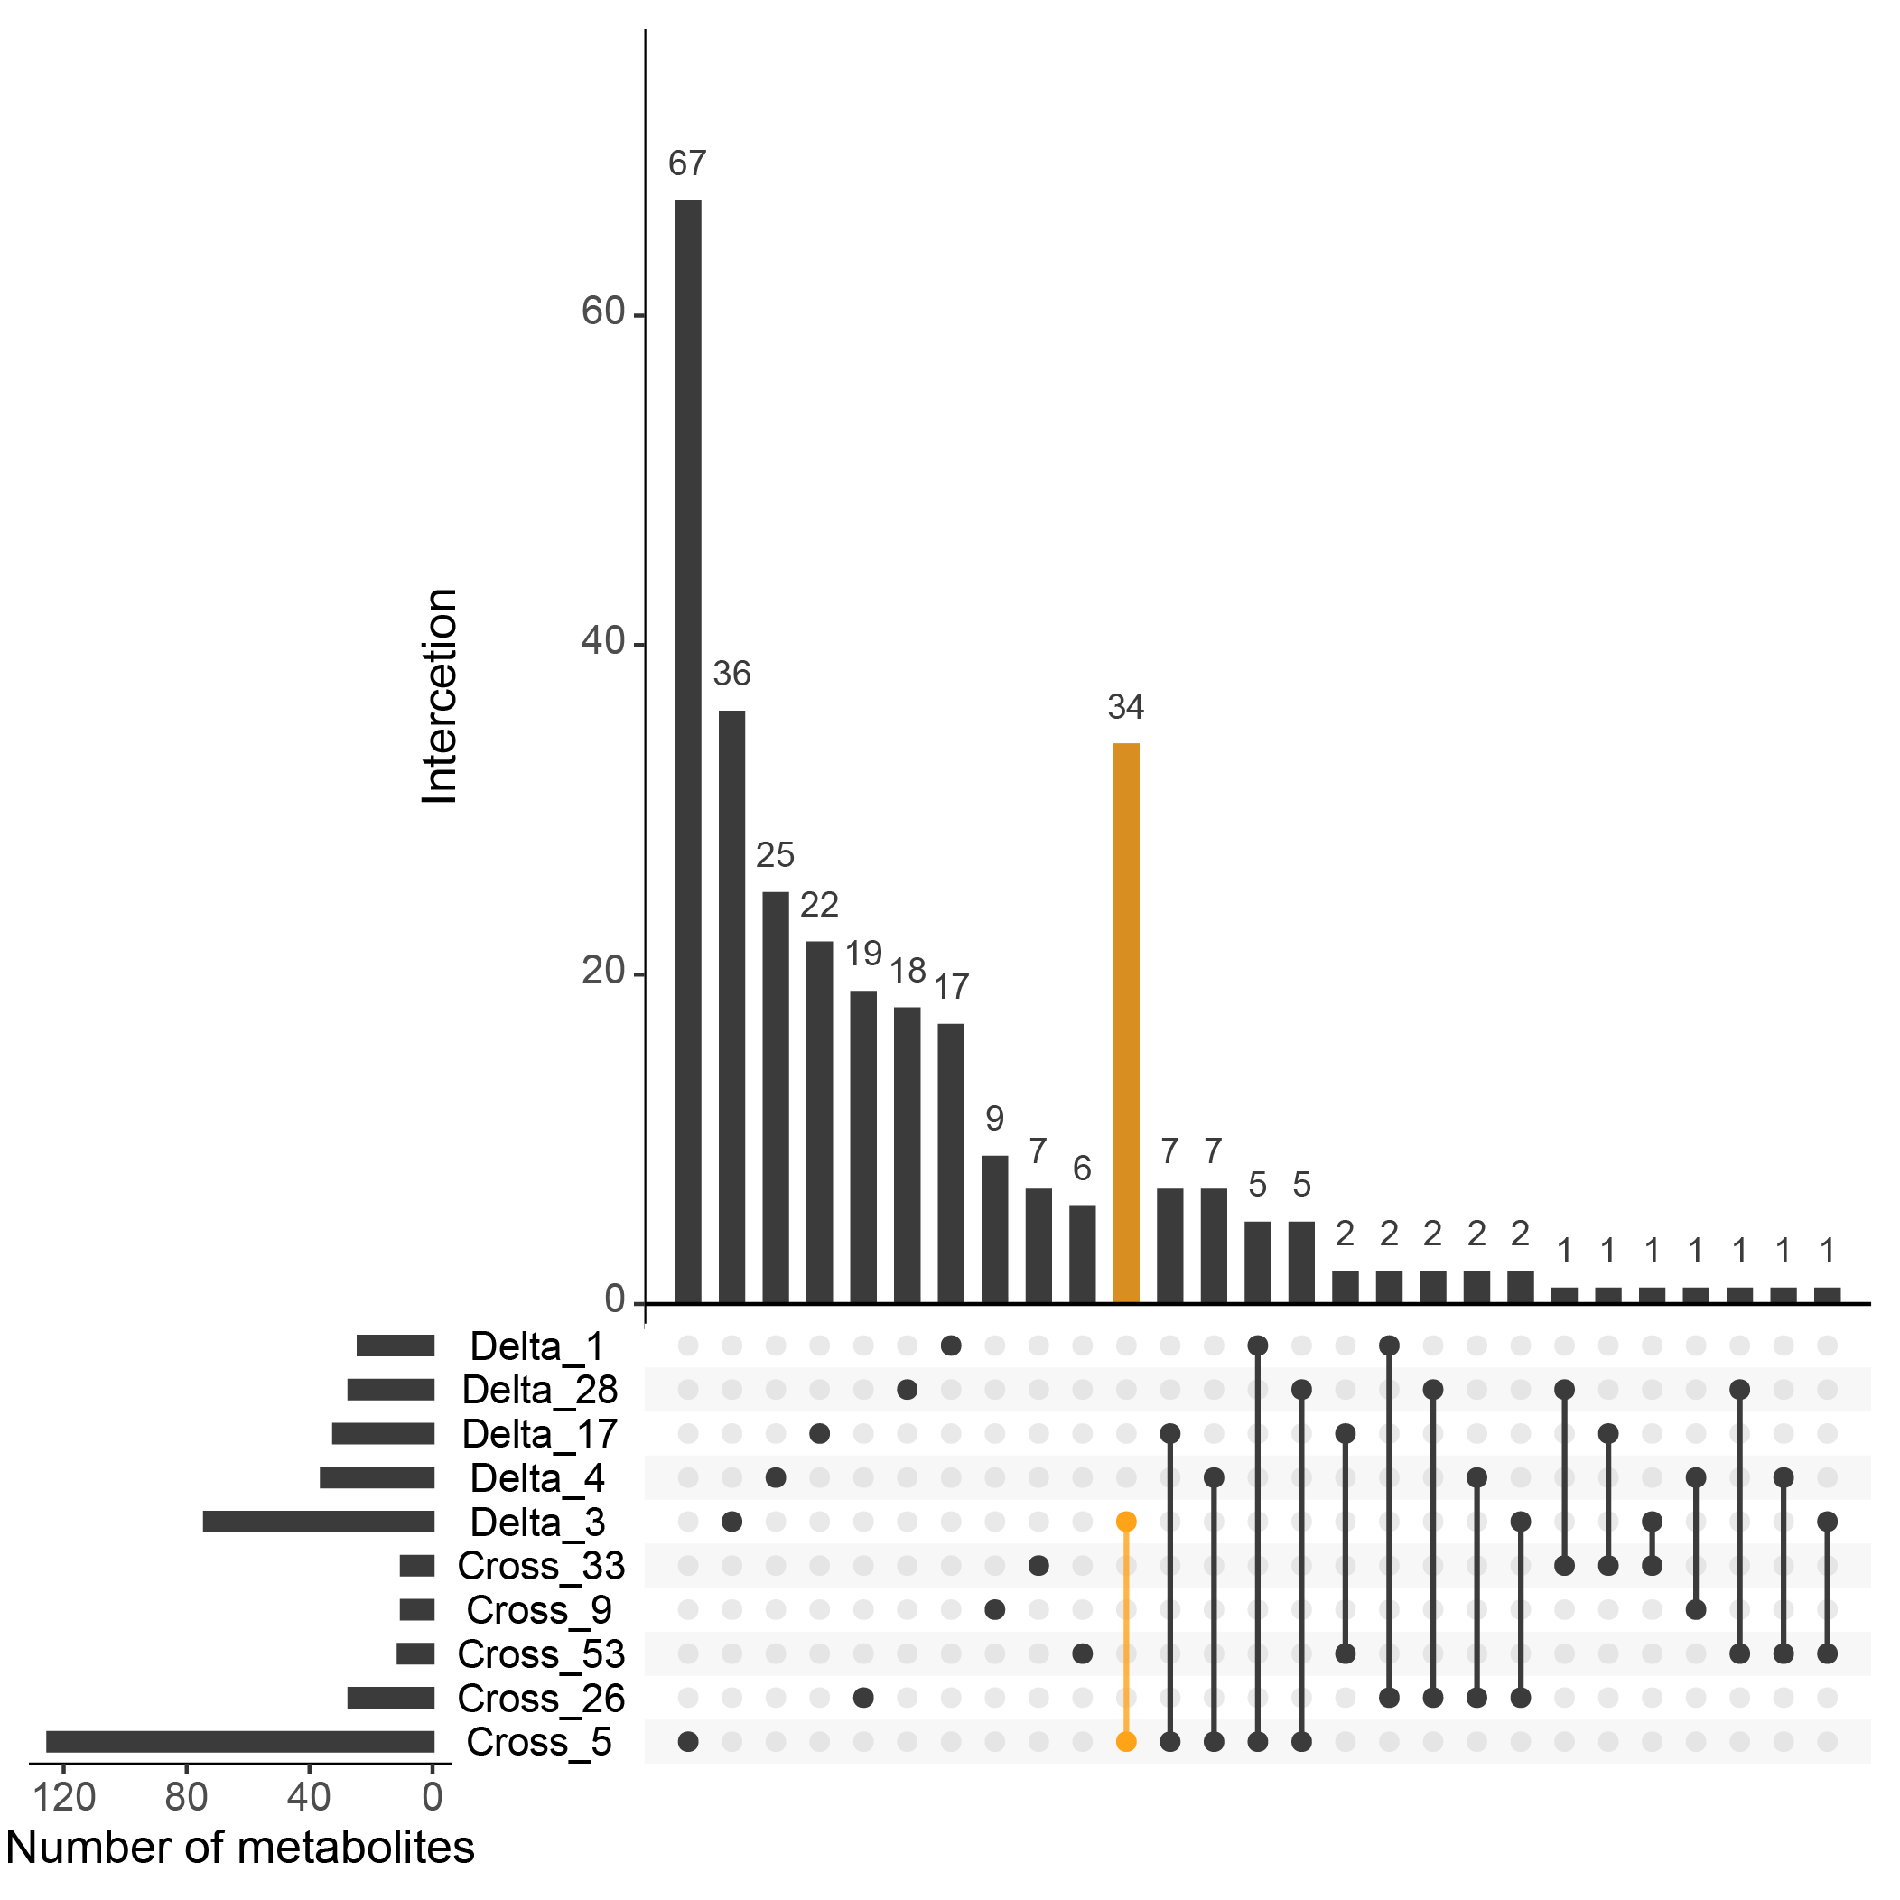
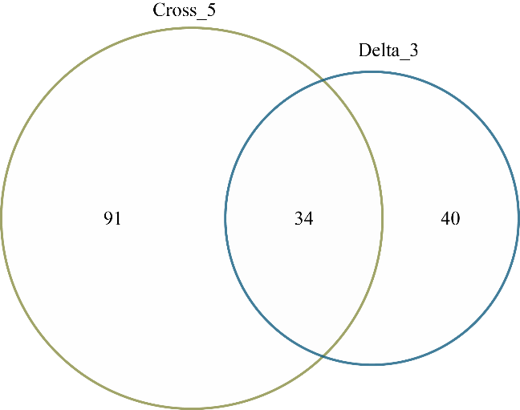
Overlap between subnetworks from two correlation networks

Slide 27
Study design
All patients
Randomly divide
Discovery dataset
Validation dataset
Discovery dataset
Lasso
RF
SVM
ANN
Potential biomarker selection
Parameter optimization
Prediction model

Slide 28
GA week prediction (Summary)
Internal validation data set
Model | RMSE | Adjusted R² | P-value
Lasso | 3.35 | 0.69 | < 2.2*10⁻¹⁶
Random Forest | 3.27 | 0.74 | < 2.2*10⁻¹⁶
Support Vector Machine | 4.04 | 0.62 | < 2.2*10⁻¹⁶
Artificial Neuronal Network | 3.89 | 0.66 | < 2.2*10⁻¹⁶
External validation data set
Model | RMSE | Adjusted R² | P-value
Lasso | 3.59 | 0.63 | < 2.2*10⁻¹⁶
Random Forest | 3.38 | 0.70 | < 2.2*10⁻¹⁶
Support Vector Machine | 4.16 | 0.57 | < 2.2*10⁻¹⁶
Artificial Neuronal Network | 5.87 | 0.33 | < 2.2*10⁻¹⁶

Slide 29
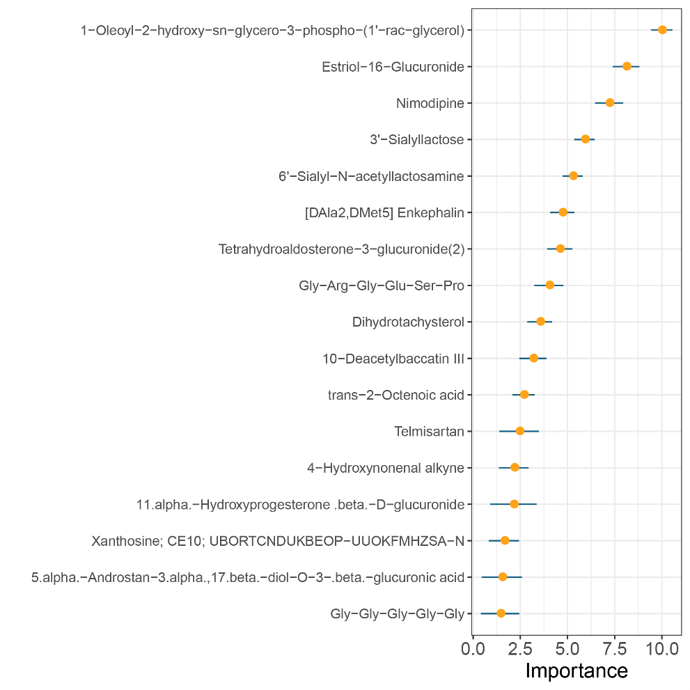
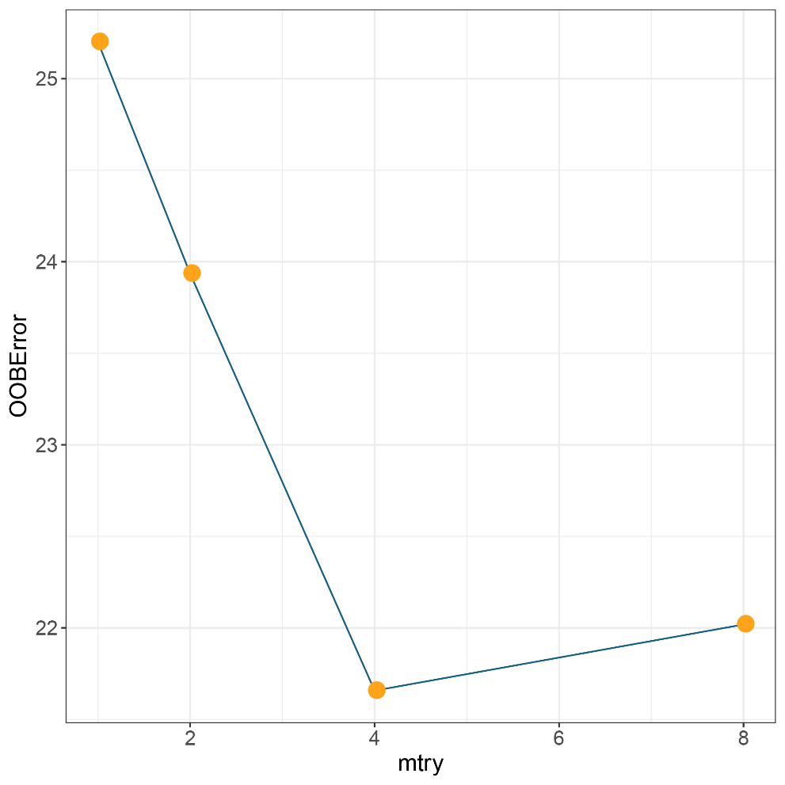
Potential marker and parameter optimization
Random forest model

Slide 30
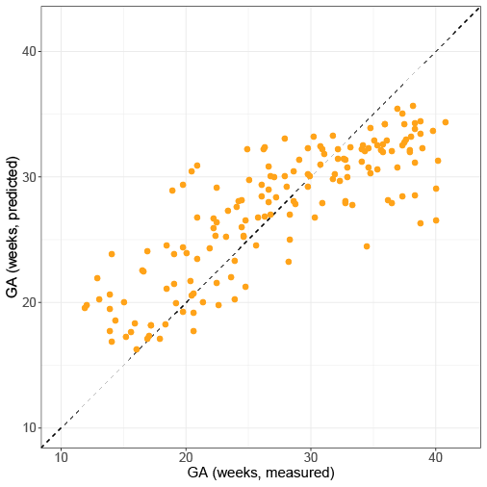
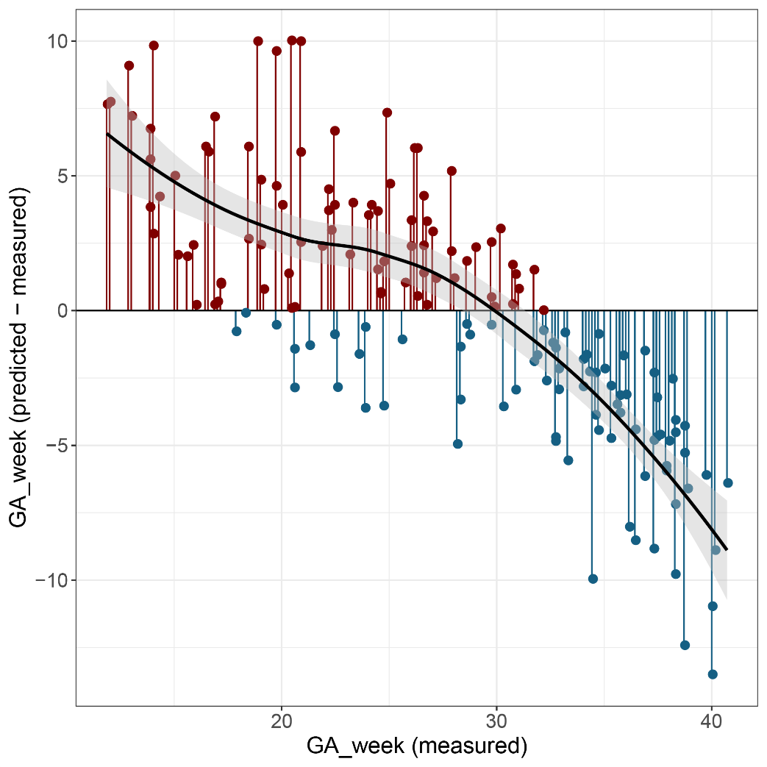
Prediction error according to GA
Discovery data set

Slide 31

Linear regression to correct prediction models
Correct RF prediction results
Correction linear regression =
lm(formula = measured GA~ RF Predicted GA)

Slide 32
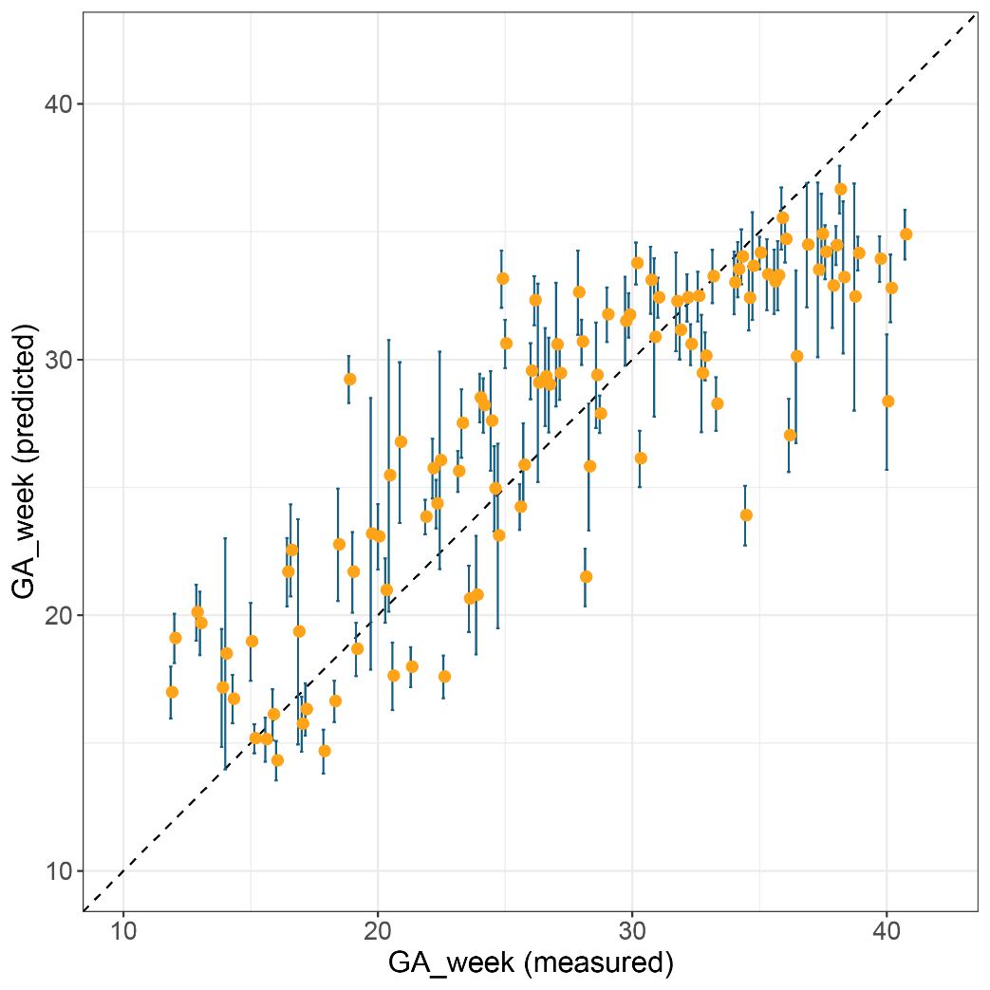
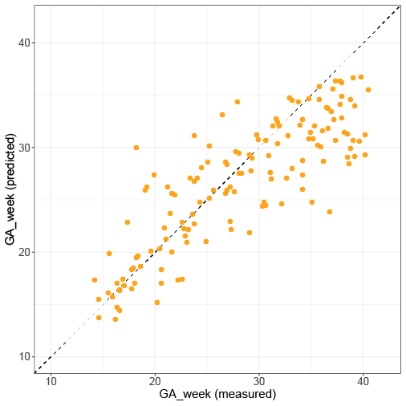
Urine metabolome can predict GA
Internal validation dataset
External validation dataset
Adjusted R²: 0.74
RMSE: 3.27 (weeks)
P-value < 2.2*10⁻¹⁶
Adjusted R²: 0.70
RMSE: 3.38 (weeks)
P-value < 2.2*10⁻¹⁶

Slide 33
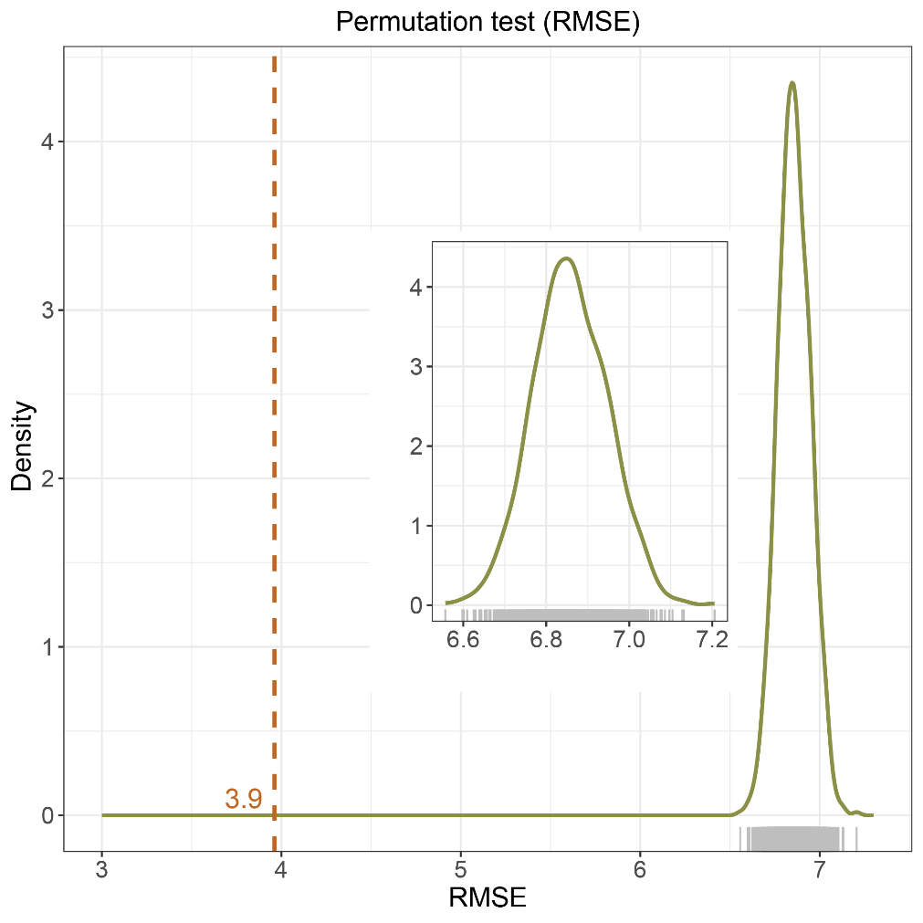
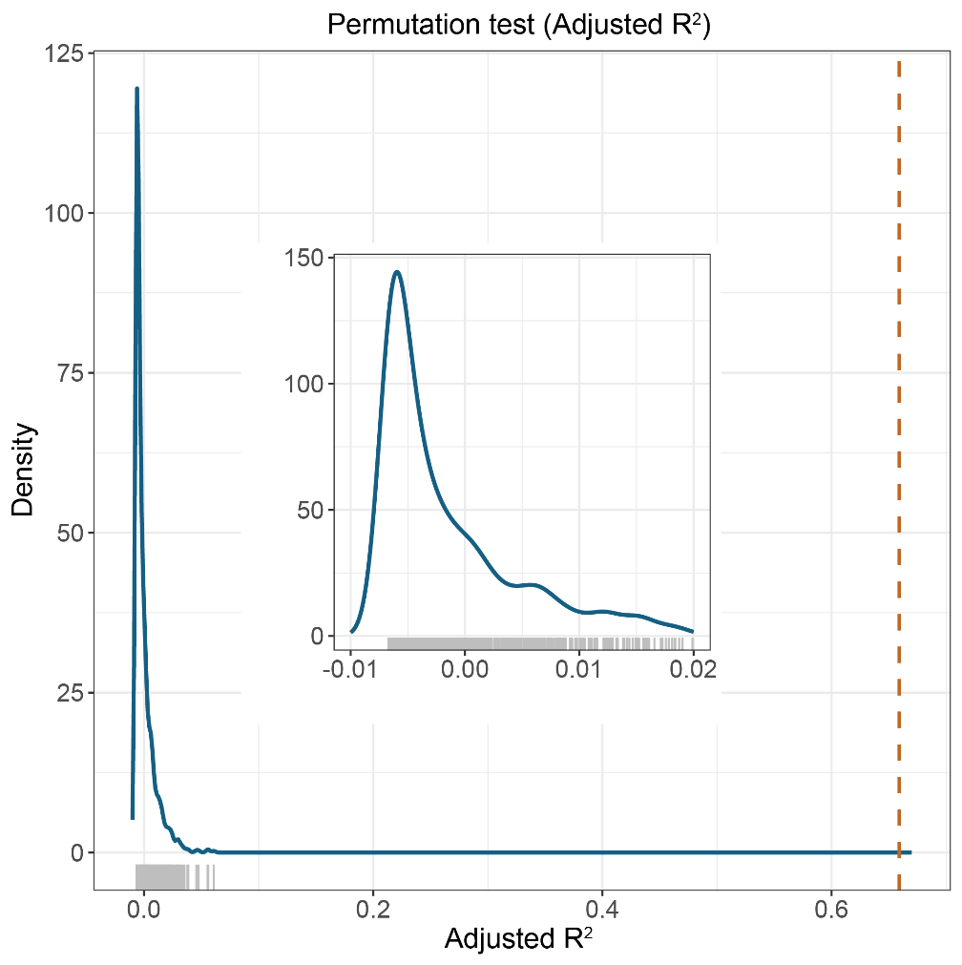
Permutation test show no overfitting

Slide 34
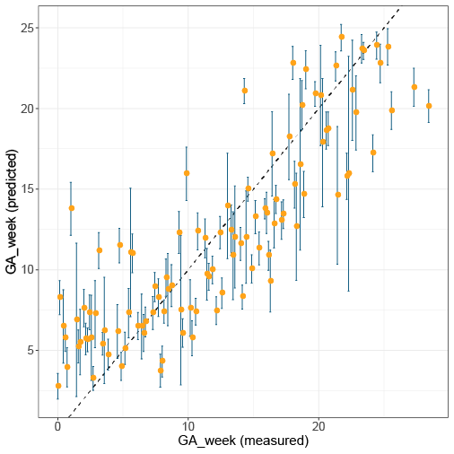
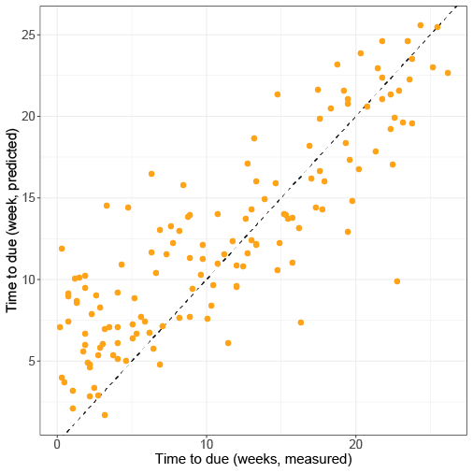
Predict time to due
Internal validation dataset
External validation dataset
Adjusted R²: 0.73
RMSE: 3.10 (weeks)
P-value < 2.2*10⁻¹⁶
Adjusted R²: 0.72
RMSE: 3.29 (weeks)
P-value < 2.2*10⁻¹⁶

Slide 35
Predict time to due
Correlation network analysis
External validation dataset

